Slide 1
Writing Good C++ Code
Lesson 3-1 Return by reference in C++
Pan, Shuye

Slide 2
OUTLINE
WHAT (Simple Example)
WHY
HOW
WARNINGS

Slide 3
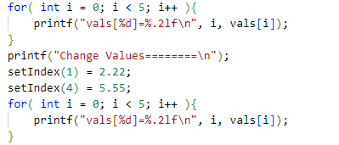
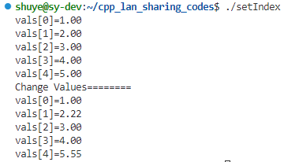
WHAT (Simple Example)
DataType& functionName(parameters);
vector<double> vals = {1, 2, 3, 4, 5};
double& setIndex(int i){
double& ref = vals[i];
return ref;
}
Notes:
类型标识符 &函数名（形参列表及类型说明）{ //函数体 }

Slide 4
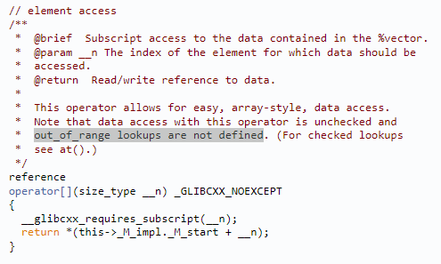
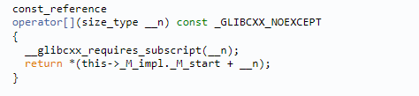
WHY
- 函数类型可为左值
STL 可以保持和C原生数组接口一致性

Slide 5
WHY
- 函数类型可为左值
STL 可以保持和C原生数组接口一致性
- VS返回值: 在内存中不产生的副本
Rational a(1,2);
Rational b;
b = a;
- 随着编译器优化, 差别变小
//operator =
a = b = c;
(a = b) = c;
//operator *+-/
a = b*c*d ;
//iostream << >>
cout << a << b << endl;
Rational operator=(const Rational& obj)
- 连续运算符
Rational& operator =(const Rational& obj)
Notes:
多一次拷贝构造.

Slide 6
HOW – return reference
- 返回参数的引用
const string &shorterString(const string &s1,const string &s2){
return s1.size()<s2.size()?s1:s2;
}
- 返回成员变量(simple example)
double& setIndex(int i){
double& ref = vals[i];
return ref;
}
- 返回this指向的对象
ListNode<T>& operator=(const ListNode<T>& obj){
if(this == &obj ){
return *this;
}
this->data = obj.getData();
this->next = obj.next;
return *this;
}
- operator return *this;
operator=
operator<<
operator*
Notes:
返回参数的引用(该参数本身也是引用) 返回成员变量(要谨慎)
返回this指向的对象, operator返回*this的这种形式, 被所有内置类型和标准库类型(string, vector, complex)共同遵守:

Slide 7
HOW – operator<<
template <typename T>
void printList(ListNode<T>* head) {
ListNode<T>* p = head;
while (p) {
std::cout << p->getData() << std::endl;
p = p->getNext();
}
}
template<class U>
std::ostream& operator<< (
std::ostream& os, const ListNode<U>* node){
os << node->getData();
ListNode<U>* p = node->getNext();
while( p ){
os << "->" << p->getData();
p = p->getNext();
}
os << std::endl;
return os;
}
printList(node1);
std::cout << node1;

Slide 8
HOW – operator*
class Rational{
public:
Rational(int _fz=0, int _fm=1): fz(_fz), fm(_fm){}
private:
int fz, fm;
friend const Rational operator* (
const Rational& lhs, const Rational& rhs){
return Rational( lhs.fz * rhs.fm, lhs.fz * rhs.fm );
}
};
int main(){
Rational a(1,2);
Rational b(3,5);
Rational c = a*b;
return 0;
}
考虑优化加引用?
//Create local variable in Stack.
friend const Rational& operator* (
const Rational& lhs, const Rational& rhs){
Rational result( lhs.fz * rhs.fm, lhs.fz * rhs.fm );
return result;
}

Slide 9
WARNINGS
//Create local variable in Stack.
friend const Rational& operator* (
const Rational& lhs, const Rational& rhs){
Rational result( lhs.fz * rhs.fm, lhs.fz * rhs.fm );
return result;
}
1. 不要返回局部变量的引用
shuye@sy-dev:~/cpp_lan_sharing_codes$ g++ rational.cpp -o rational
rational.cpp: In function ‘const Rational& operator*(const Rational&, const Rational&)’:
rational.cpp:20:20: warning: reference to local variable ‘result’ returned [-Wreturn-local-addr]
20 | return result;
shuye@sy-dev:~/cpp_lan_sharing_codes$ ./rational
Segmentation fault (core dumped)

Slide 10
WARNINGS
friend const Rational& operator* (
const Rational& lhs, const Rational& rhs){
Rational* result = new Rational(
lhs.fz * rhs.fm, lhs.fz * rhs.fm );
return *result;
}
1. 不要返回局部变量的引用
2. 不要返回函数内new的内存
d = a*b*c
两个new 两个delete
内存泄漏
3. 不要返回函数内static对象
friend const Rational& operator* (
const Rational& lhs, const Rational& rhs){
static Rational result;
result = new Rational( lhs.fz * rhs.fz, lhs.fm * rhs.fm );
return result;
}
Rational a,b,c,d;
a*b == c*d
永远恒等

Slide 11
WARNINGS
class Point{....}
struct RectPoint{
Point ulhc; //upper left
Point lrhc; //lower right
}
class Rectangle{
public:
Point& upperLeft() const { return pData->ulhc; }
Point& lowerRight() const { return pData->lrhc; }
private:
std::trl::shared_ptr<RectPoint> pData;
}
1. 不要返回局部变量的引用
2. 不要返回函数内new的内存
3. 不要返回函数内static对象
4. 不要轻易返回对象内部
变量的引用(加const)
rec.upperLeft().setX(...);
会修改底层数据
加const:
const Point& upperLeft() const
该返回对象, 还是返回对象

Slide 12
QUESTIONS
What’s the difference between
Object operator= and Object& operator= ?
Try to implement class `Rational` and find out the answer.
class Rational{
public:
Rational(int _fz=0, int _fm=1): fz(_fz), fm(_fm){}
//ADD CODE HERE
private:
int fz, fm;
friend const Rational operator* (
const Rational& lhs, const Rational& rhs){
return Rational( lhs.fz * rhs.fm, lhs.fz * rhs.fm );
}
};
Rational a(1,2);
Rational b(3,5);
Rational c;
c = a * b;
(a = b) = c;

